Slide 1



Rapid Chat Made
Adam Jacoby

Slide 2
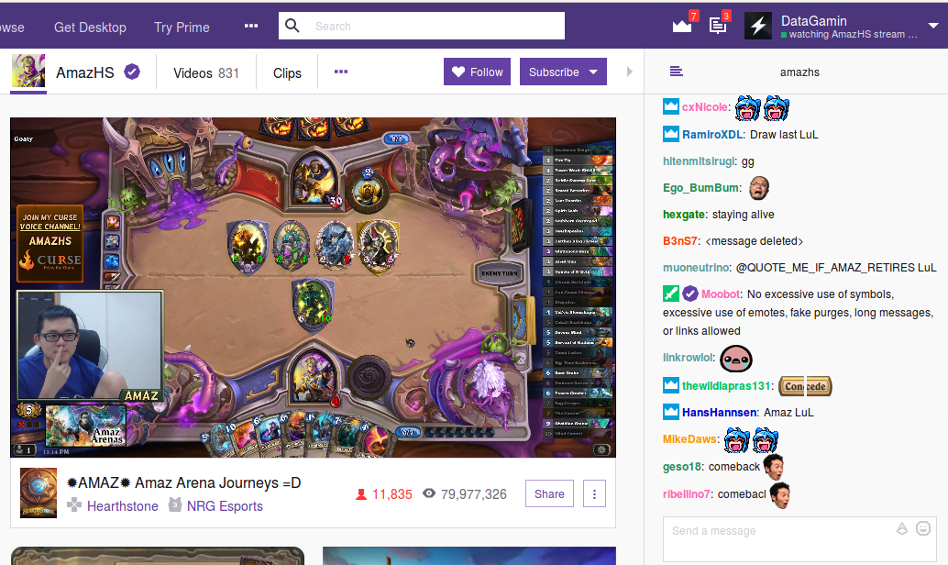
the chat moves too fast to read

Slide 3
my solution
rapidchatmadeslow.life

Slide 4


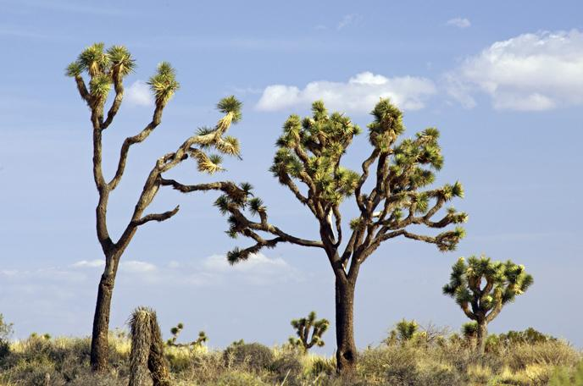



How does it work?
live data
preprocessing/
feature extraction
random forest
SQL database
web app output

Slide 5


How does it work?
live data
preprocessing/
feature extraction
random forest
SQL database
Domain Knowledge
web app output
unlabeled data
Word2Vec & Clustering

Slide 6
Chair is a pronoun?
Feature | Importance
Twitch words (darkmode, evilkappa, devilkappa, keepo, kappaclause) | 3.2%
Game words/numbers (health, mana, hp, dmg, coin, giant, wyrm) | 2.4%
Common verbs (have, see, had, need, make, play, want, kill) | 1.8%
Pronouns and names (me, iaposv, u, ur, your, their, savjz, chair) | 1.5%

Slide 7


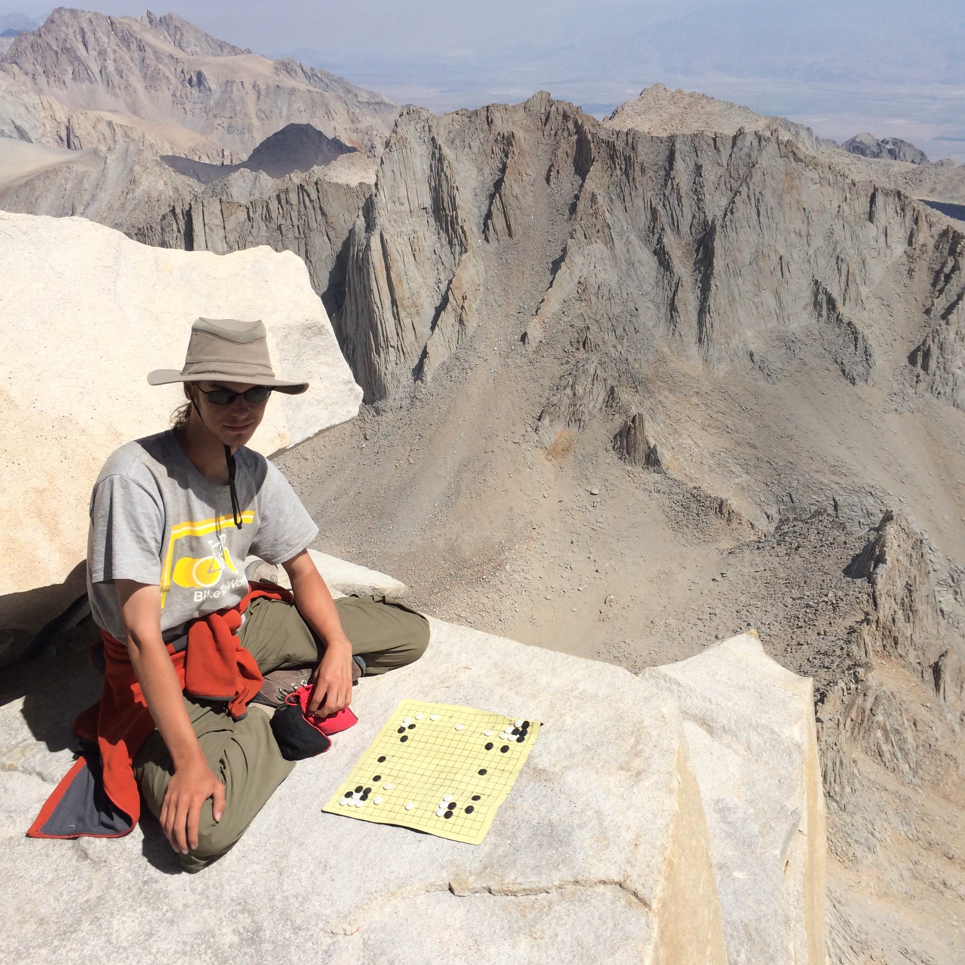



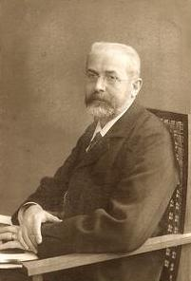

Adam Jacoby

